Slide 1
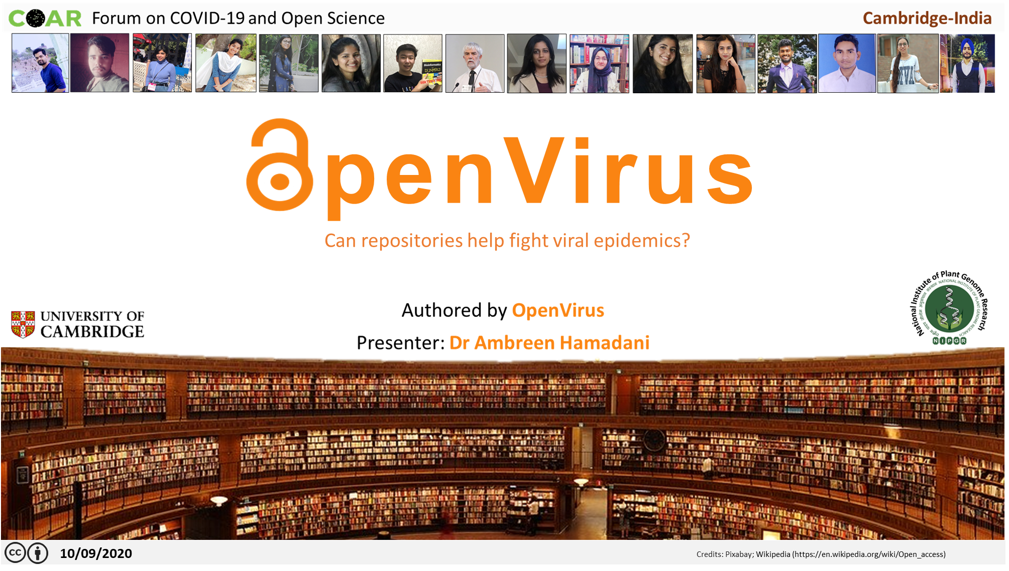

Slide 2
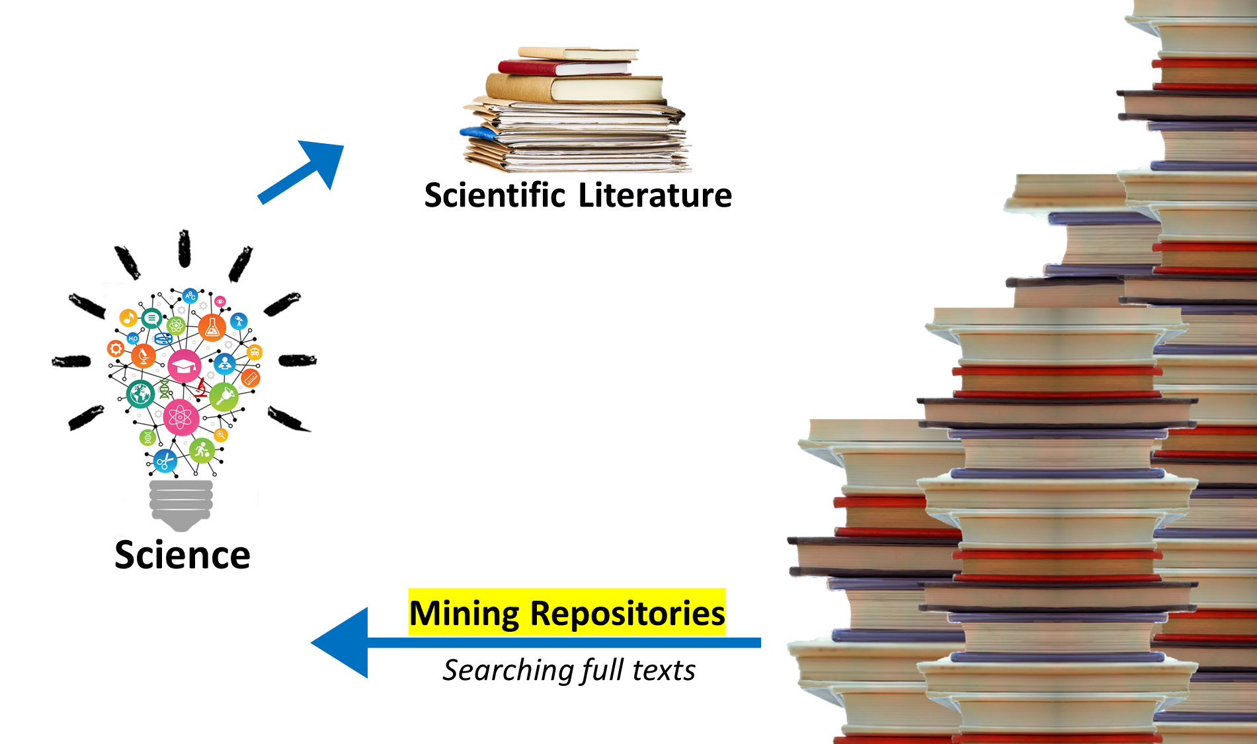



Credits: MS PowerPoint Stock Images; MS PowerPoint Icons;
Notes:
Scientific Ideas and innovations are relatively difficult to understand unless they are made tangible by turinng them into scientific literature
Highlight mining repositories lightbulb

Slide 3

Scientific Open Access
8.5 million papers
Biomedical field: >1million/year (PubMed) → 2 /min
Increasing @ 8–9% /year
COVID Publication Explosion
bioRxiv and medRxiv: 10 /day
> 16,000 – 4 months since the 1st case
Anonymous.2018. Scopus makes millions of open access articles easily discoverable. https://blog.scopus.com/posts/scopus-makes-millions-of-open-access-articles-easily-discoverable; Landhuis, E., 2016. Scientific literature: Information overload. Nature. 535: 457–458; Fraser, N., Brierley, L., Dey, G., Polka, J. K., Pálfy, M., Coates, J.A. 2020. bioRxiv 2020.05.22.111294; 10.1101/2020.05.22.111294
Notes:
Don’t read everything from the presentation
Be conversational
Ask rhetorical questions

Slide 4


Slide 5


IMPOSSIBLE to
Read it all
To conclude anything substantial
Make informed decisions without data
True for Scientists & Non-Scientists
; Pixabay
Notes:
Unless the papers are annotated , the data are semantic and published, the figures are vector diagrams - there is very little the world can do.

Slide 6
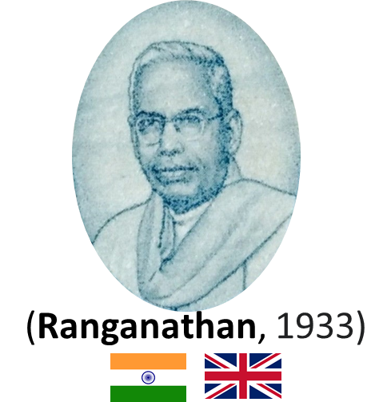
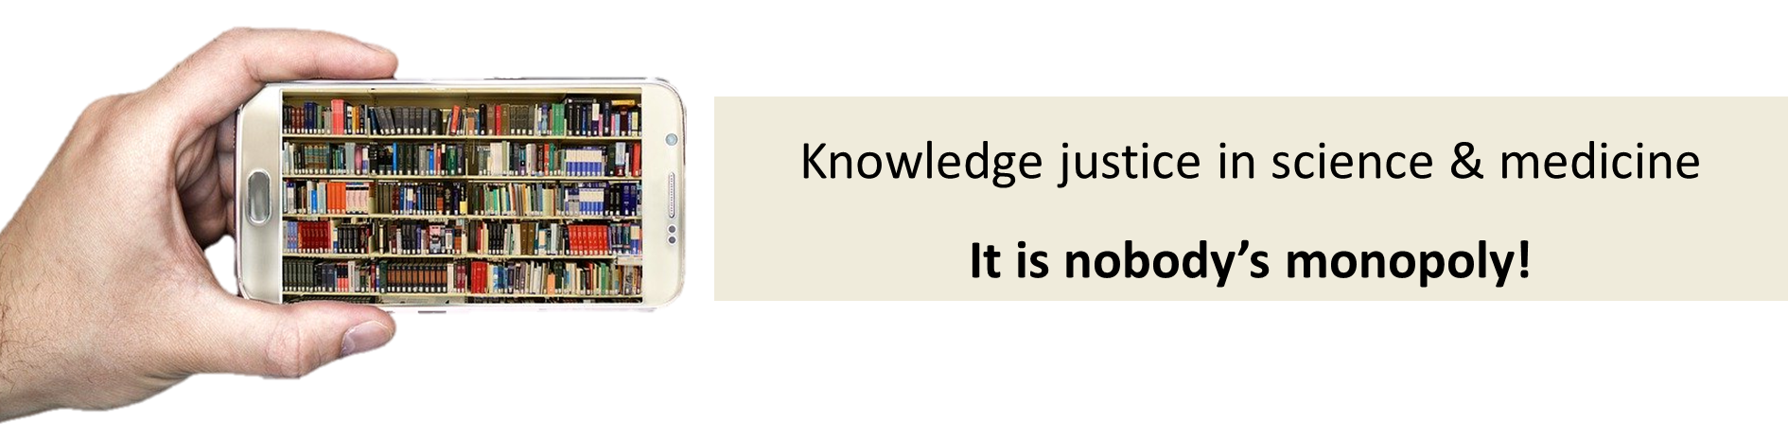

Our Inspiration
Repositories are for everyone everywhere
Save the time of the reader
A growing communal organism
Credits: India Post, Government of India - [1], GODL-India, https://commons.wikimedia.org/w/index.php?curid=74877762; By Gennadi Blindmann (gblindmann@hotmail.com) - Photo, http://www.multi-touch-solution.com/, Public Domain, https://commons.wikimedia.org/w/index.php?curid=12145131; hudsoncrafted, Pixabay
Notes:
Ranganathan should come earlier
Graphic distracting
Something abour renganathan ( india – uk and back)
We go back to the foundations of library science and the laws of Ranganathan a century ago look to the past and present
Vision translates in this century to repositories
The value of repositories

Slide 7
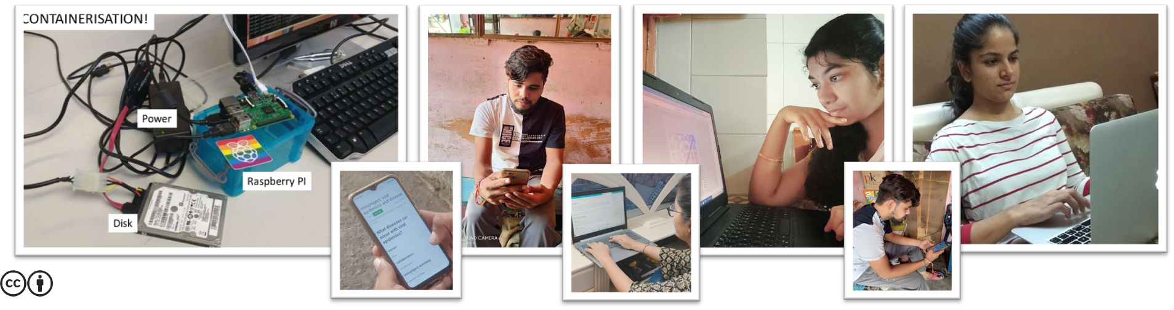
Our Vision
Scrape
Annotate
Search
Work on local machines or just mobiles
Notes:
People working on poor connections in a rural environment

Slide 8

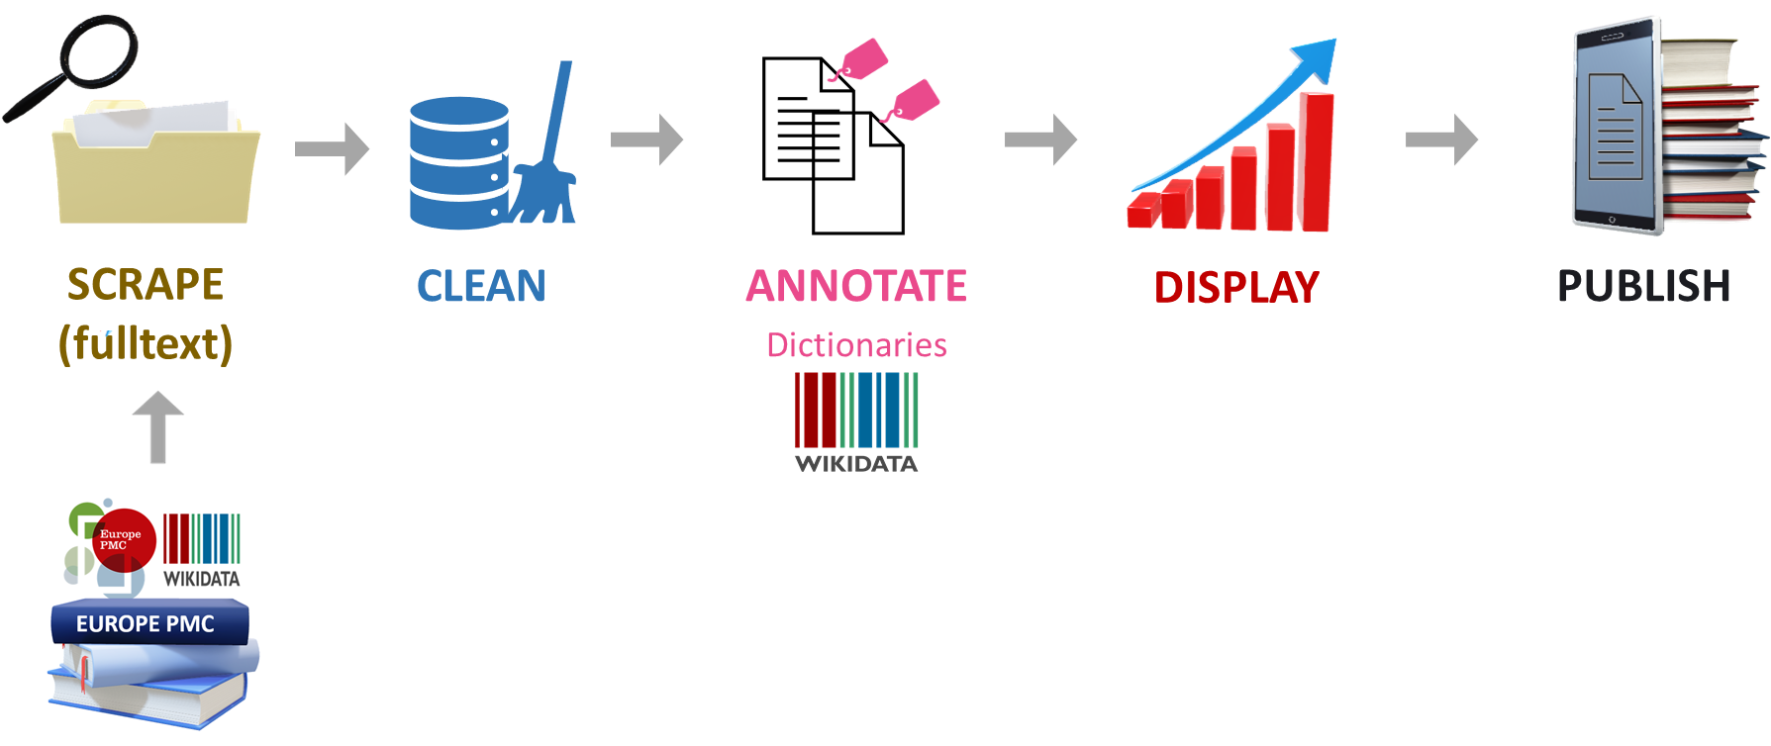
penVirus
Endeavoring to extract pearls from an ocean of Knowledge
Credits: MS PowerPoint 3D Models; Wikipedia (https://en.wikipedia.org)
Notes:
As I see it
https://digitalpublishing101.com/services/guided-self-publishing/

Slide 9


Our Tools
NEW
getpapers
Scraper for downloading scientific literature
Metadata
Full texts
Repository
Open life science publications
Hundreds of papers/min
Credits: https://www.wikidata.org/wiki/Wikidata:Main_Page
Notes:
Remove excessive graphics/ remove buttons
Remove words unnecessary

Slide 10


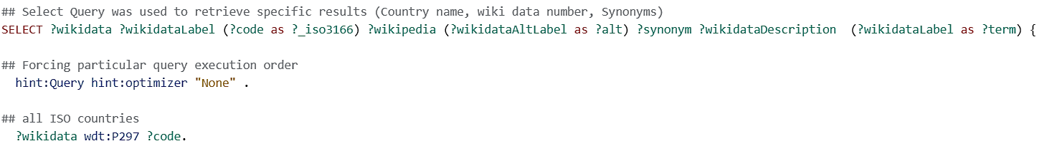
Wikidata-based Annotation
Wikidata → Dictionaries
Central storage for the structured data
World’s metadata (100 million)
Sample Query
Credits: https://www.wikidata.org/wiki/Wikidata:Main_Page
Notes:
Annotations are biological terms or relations, such as diseases, chemicals or protein interactions, which can be highlighted for readers on abstracts and full text articles. These terms are identified by text mining algorithms, developed by a variety of text mining groups.
Entity in context - results.xml
Globalizing search
Aim
Identify words and phrases in documents
Provide links to their context (ontologies)

Slide 11
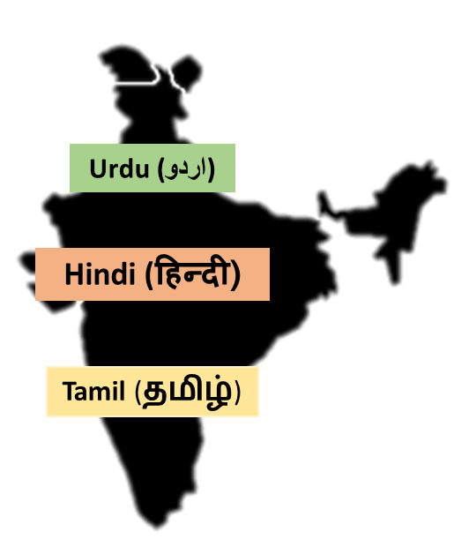
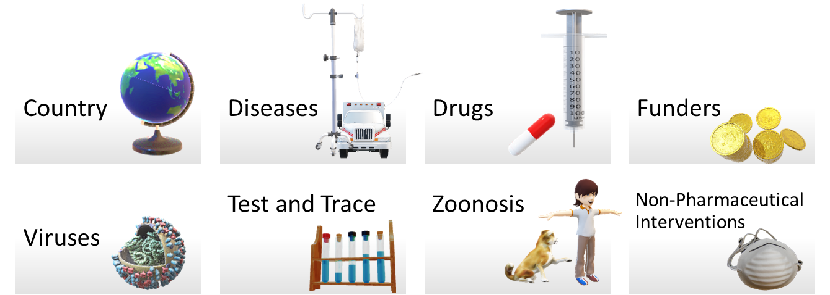
Dictionaries
MULTILINGUAL
Extract multidisciplinary knowledge about
“Viral Epidemics”
Masks
5000+ Terms
Animal carriers of disease
By Version 1 by Nohat (concept by Paullusmagnus); Wikimedia. - File:Wikipedia-logo.svg as of 14 May 2010T23:16:42, CC BY-SA 3.0, https://en.wikipedia.org/w/index.php?curid=33285413
Notes:
Wikidata and Wikipedia globe
Slide for minicopus
Make it clearer __ explain well
Explain zoonosis
Dictionaries are often called ontology
Critical for annotations and Ontology
Ontology

Slide 12
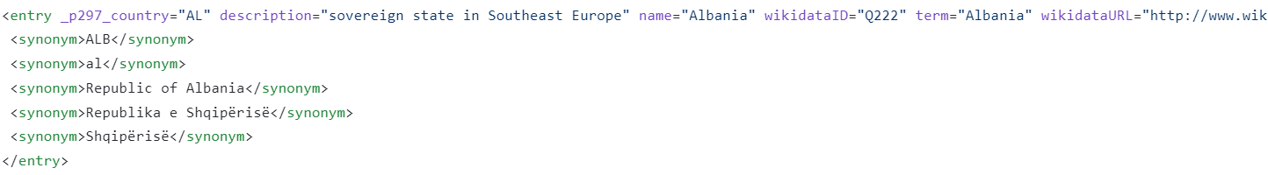
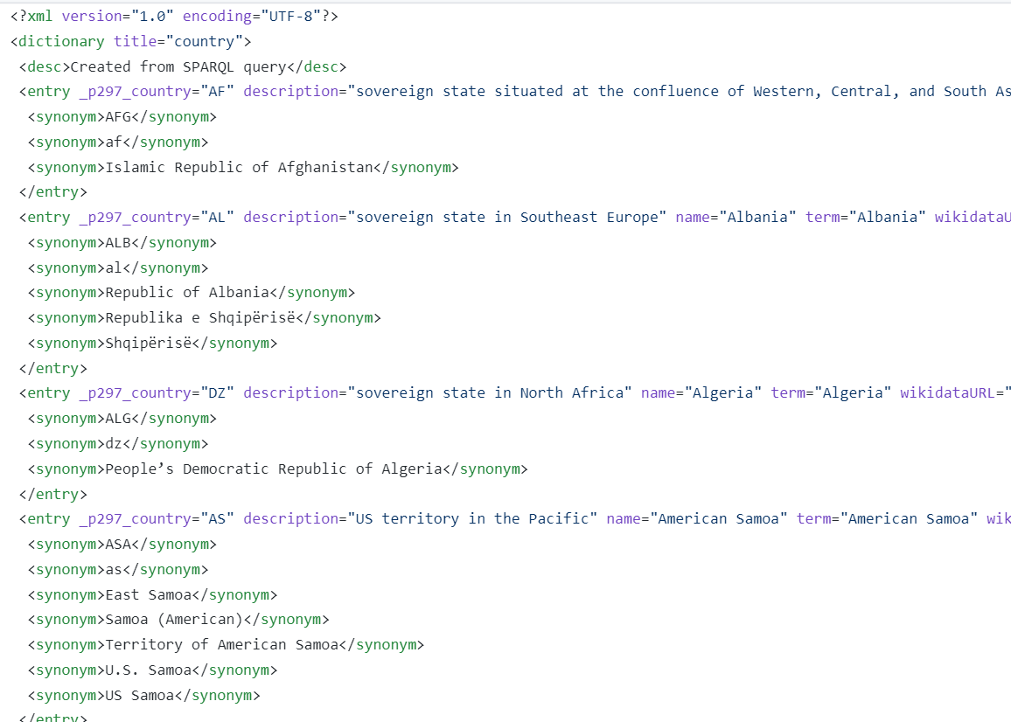
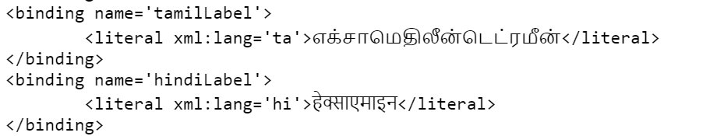
What a dictionary looks like
Multilingual
Notes:
Put less jargon

Slide 13
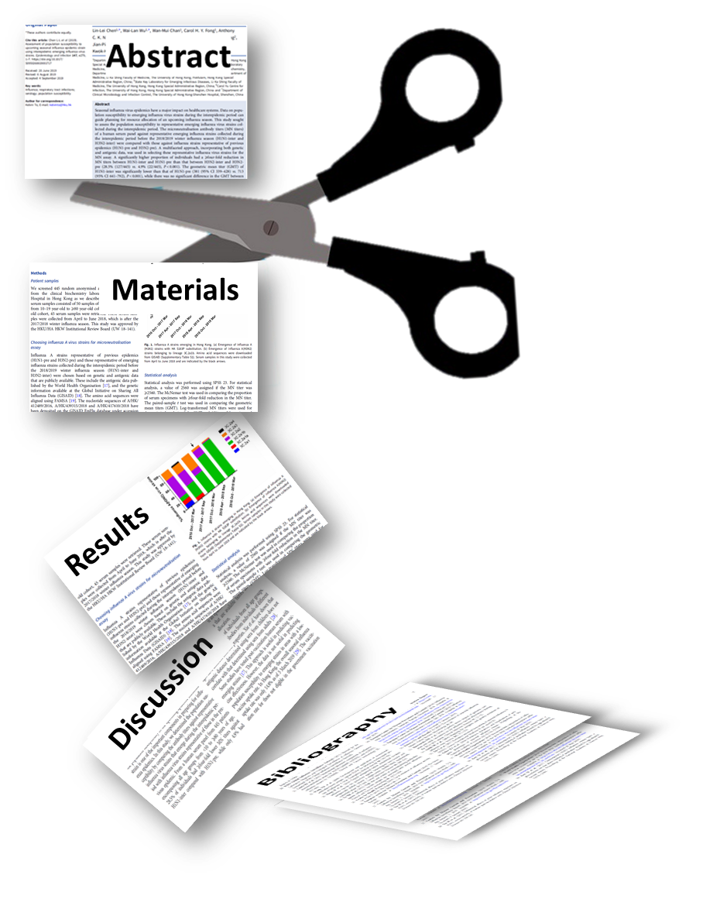
Full Text Search
Article Sections
<JATS> : Journal Article Tag Suite
Notes:
Scissors cutting the paper (introduction etc.)

Slide 14





How We Built Our Team
“When you are surrounded by people who share passionate commitment around a common purpose, anything is possible”
Howard Schultz
Mentors
Mentees
Mentors
Mentees
Notes:
Scissors cutting the paper (introduction etc.)

Slide 15
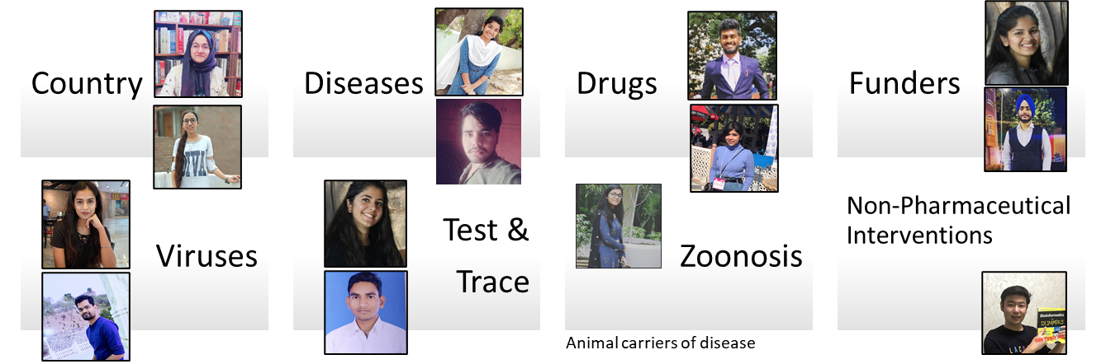
Faceted Mini Corpora
getpapers
EPMC has:
19000 (papers on Viral Epidemics)
Split into facets
Limited to: (local)
1000
“Viral Epidemics and …”
Credits: MS PowerPoint 3D Models; Wikipedia (https://en.wikipedia.org)
Notes:
Wikidata and Wikipedia globe
Slide for minicopus
Image of the people involved in each project
Numbers if we do not limit the search
Picture of local machines

Slide 16
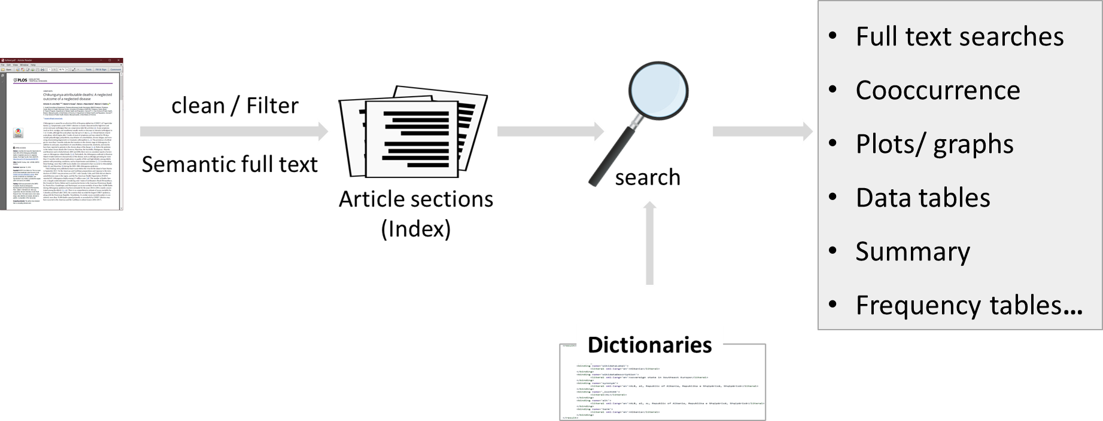

NEW
AMI Full text scientific search
Credits: MS PowerPoint Icons
Notes:
Technical words try to remove
Explain ami a little more
amidict as well
Explain article sections

Slide 17
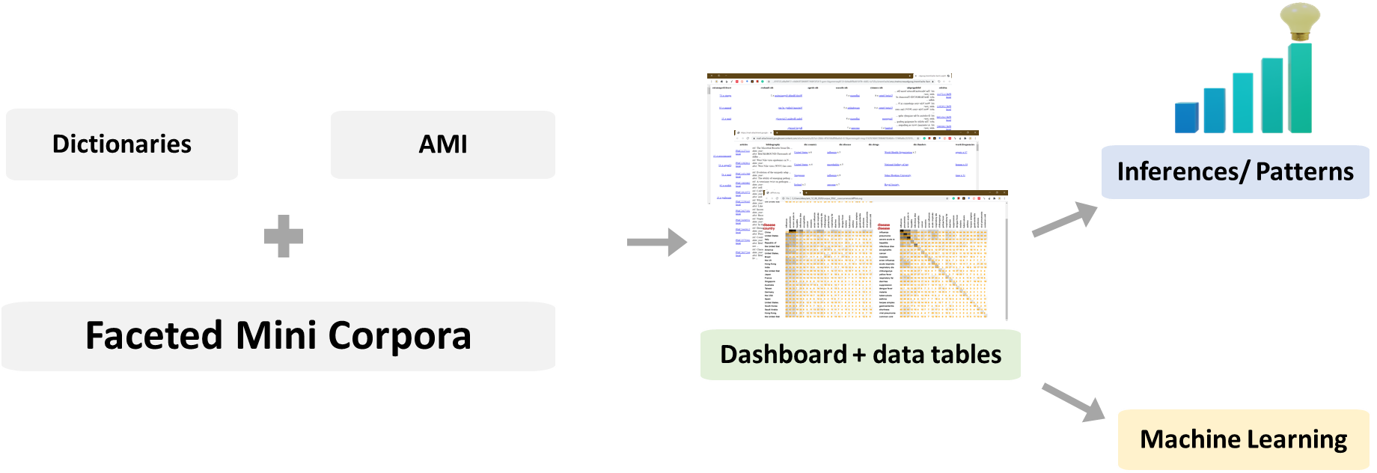
Getting Results
Credits: MS PowerPoint 3D Models;
Notes:
Build a dictionary
Scrape
Search the minicorpus
Tell the story

Slide 18
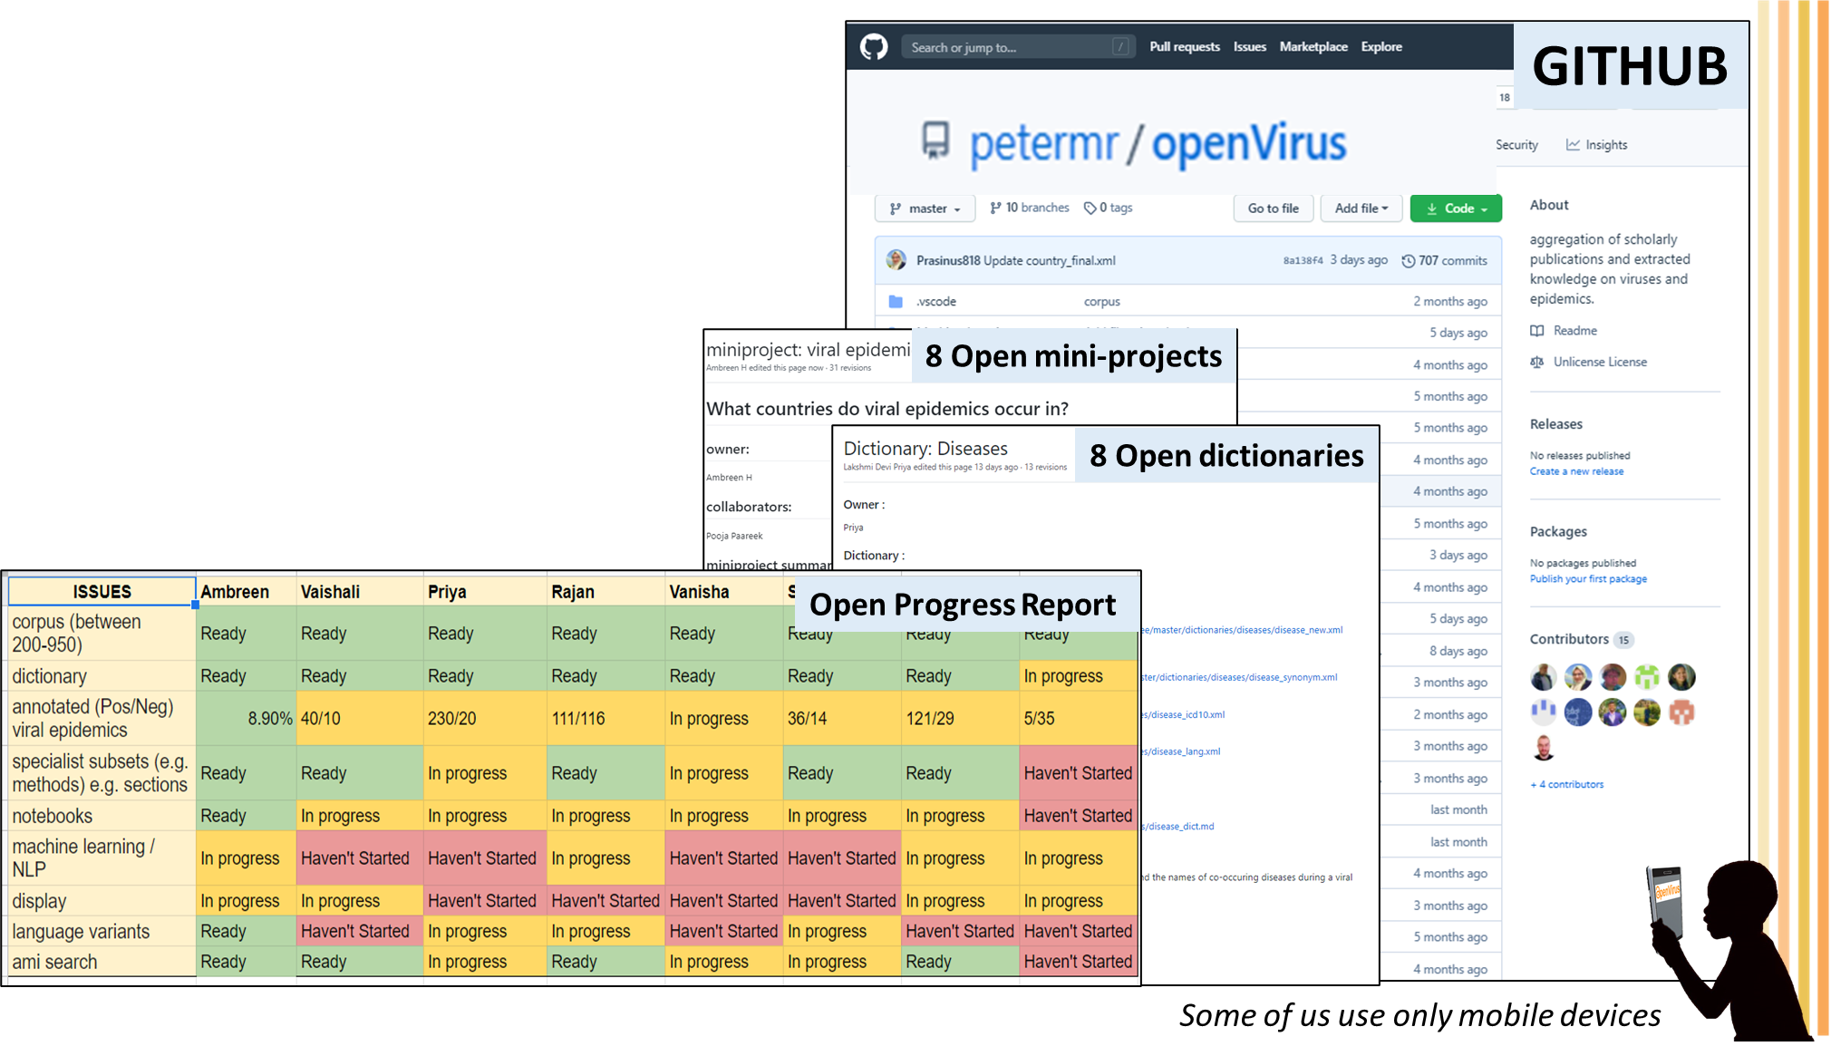

We work in the open
Meet Biweekly (virtually):
Abuzz with Ideas
Update our progress
Show it to the World
Credits: MS PowerPoint Icons
Notes:
Move to the left ( the text)

Slide 19
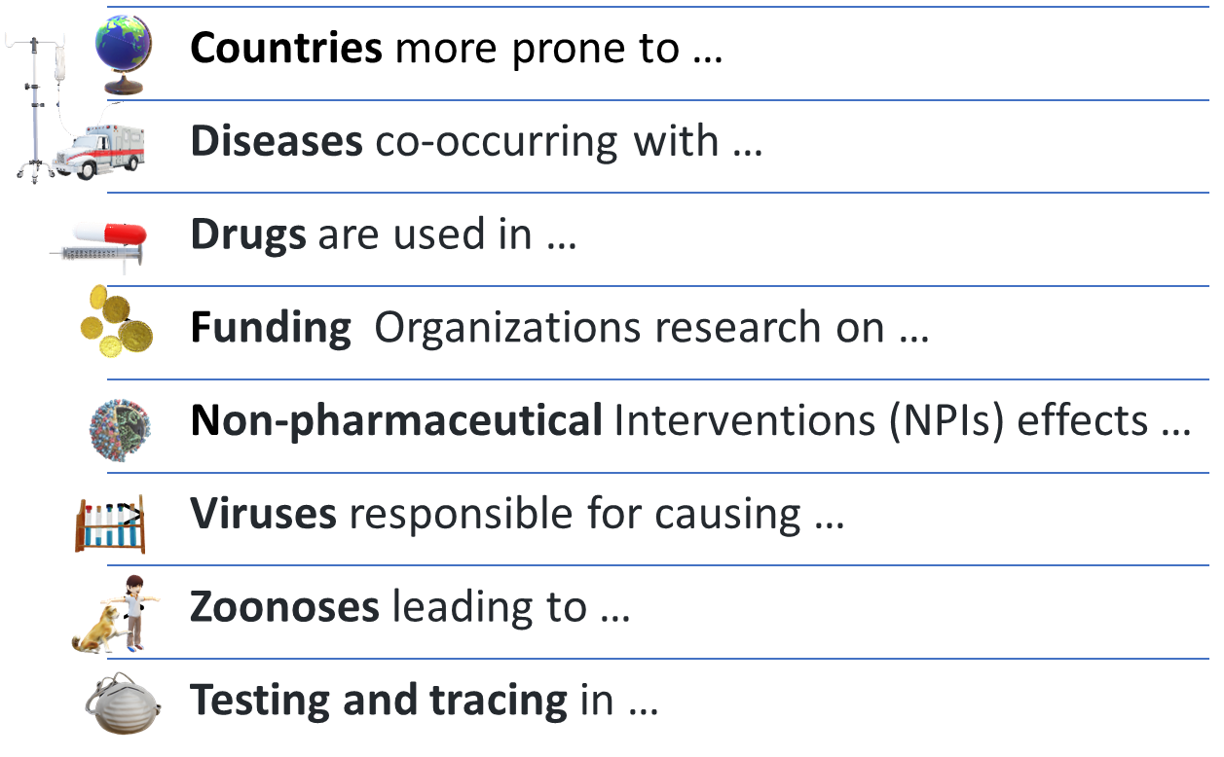
Mini Projects for gathering insights
Viral
Epidemics
Credits: MS PowerPoint 3D Models;

Slide 20
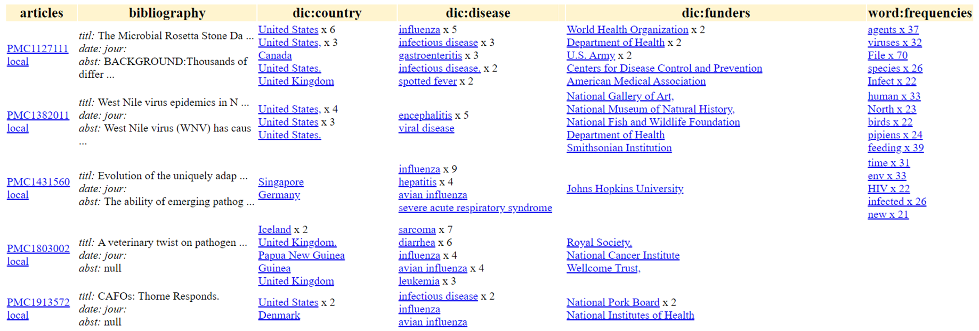
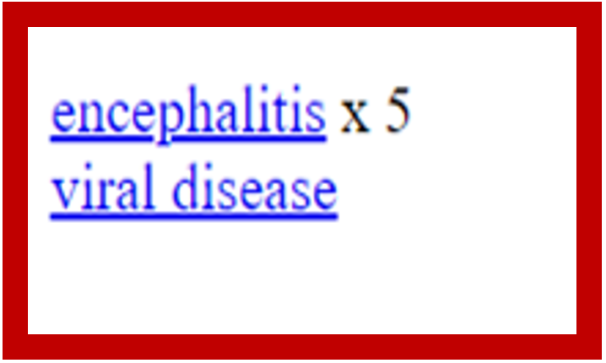
Multi-dictionary search dashboard
Dictionaries
Articles
Notes:
Zoom in on one
Change to
The first thing that people see is a dashboard and then they can look at particular things

Slide 21
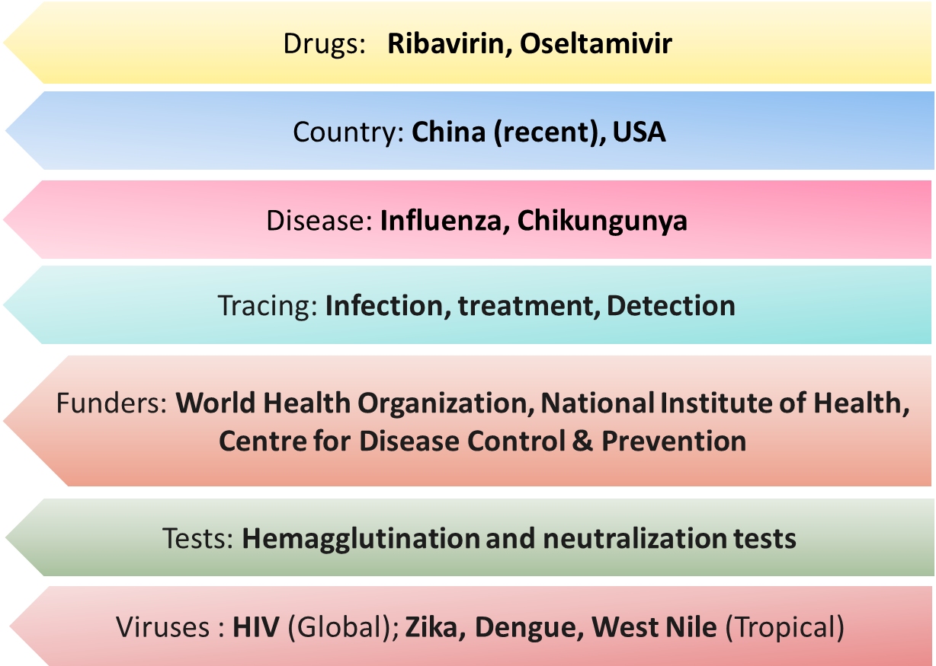
Commonest Terms
Notes:
Rajan ideas
Conclusion more
Example of a few papers specific conclusions
All mini p

Slide 22
What repositories tell us!
Viral Diseases in India
Diseases
Notes:
Precision. precision = (TP) / (TP+FP) TP is the number of true positives, and FP is the number of false positives. ...
Recall. recall = (TP) / (TP+FN)

Slide 23
What repositories tell us!
Common Viral Diseases
Notes:
Precision. precision = (TP) / (TP+FP) TP is the number of true positives, and FP is the number of false positives. ...
Recall. recall = (TP) / (TP+FN)

Slide 24
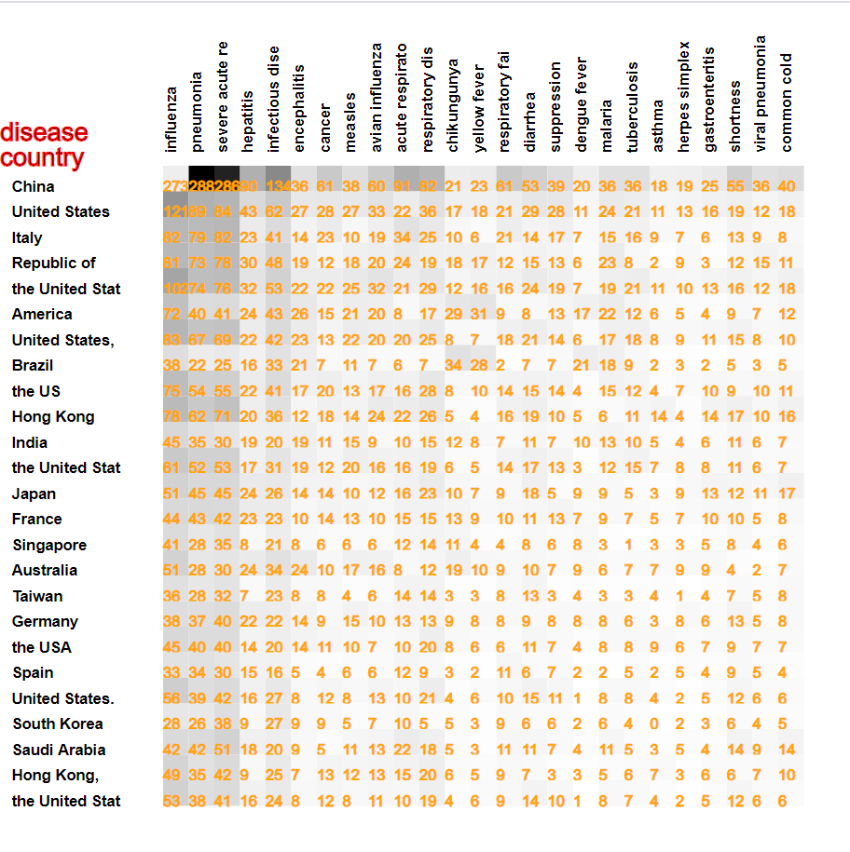
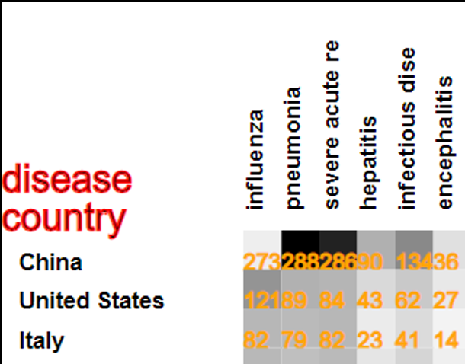
What the Results Look Like
273 | 288 | 286 | 90 | 134 | 36
121 | 89 | 84 | 43 | 62 | 27
82 | 79 | 82 | 23 | 41 | 14
Cooccurrence of Diseases with Countries
Notes:
Include only a few countries
Explain cooccurrence a little bit more
Magnify the top corner
Explain cooccurrence
What concepts are closely related in the text

Slide 25
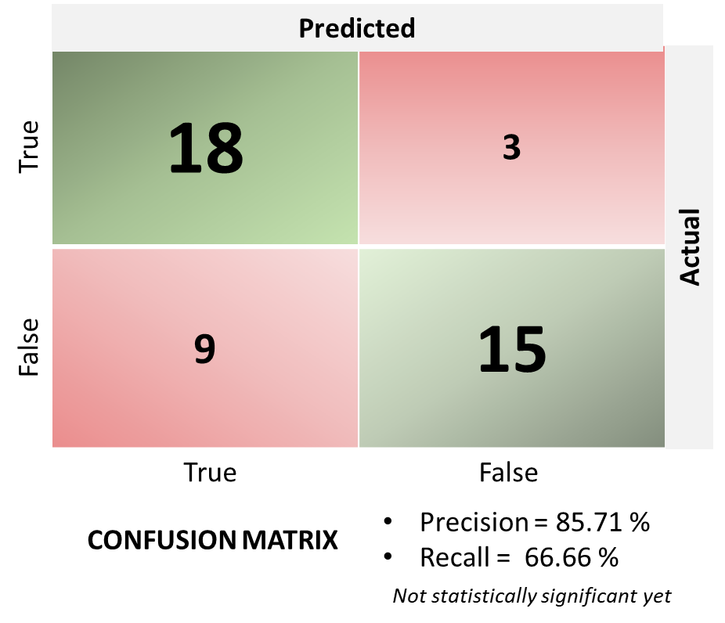
Machine Learning
How good is EPMC search?
Annotated hundreds of papers for false positives (Not Viral Epidemics)
Endeavouring to ask and answer
NEW Questions
Can we find pattens → prevent & control pandemics
?
Notes:
Precision. precision = (TP) / (TP+FP) TP is the number of true positives, and FP is the number of false positives. ...
Recall. recall = (TP) / (TP+FN)
Rerun on a larger set
<result pre="as observed under pathological conditions such as in cancer and" exact="autoimmune disease" post="might provide an opportunity for pharmacological interference targeting the"/>

Slide 26
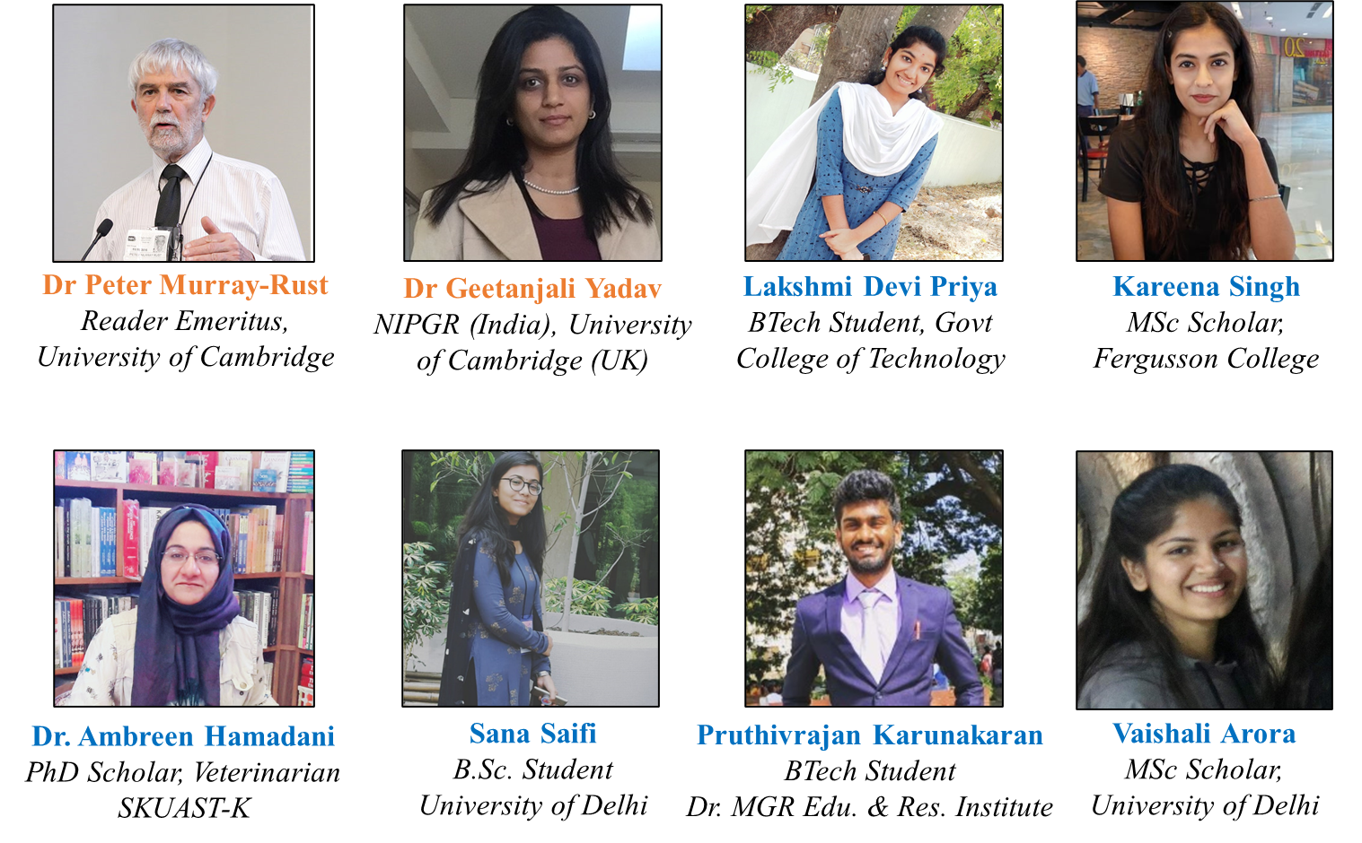
Our Colorful Team
UK, India, China

Slide 27
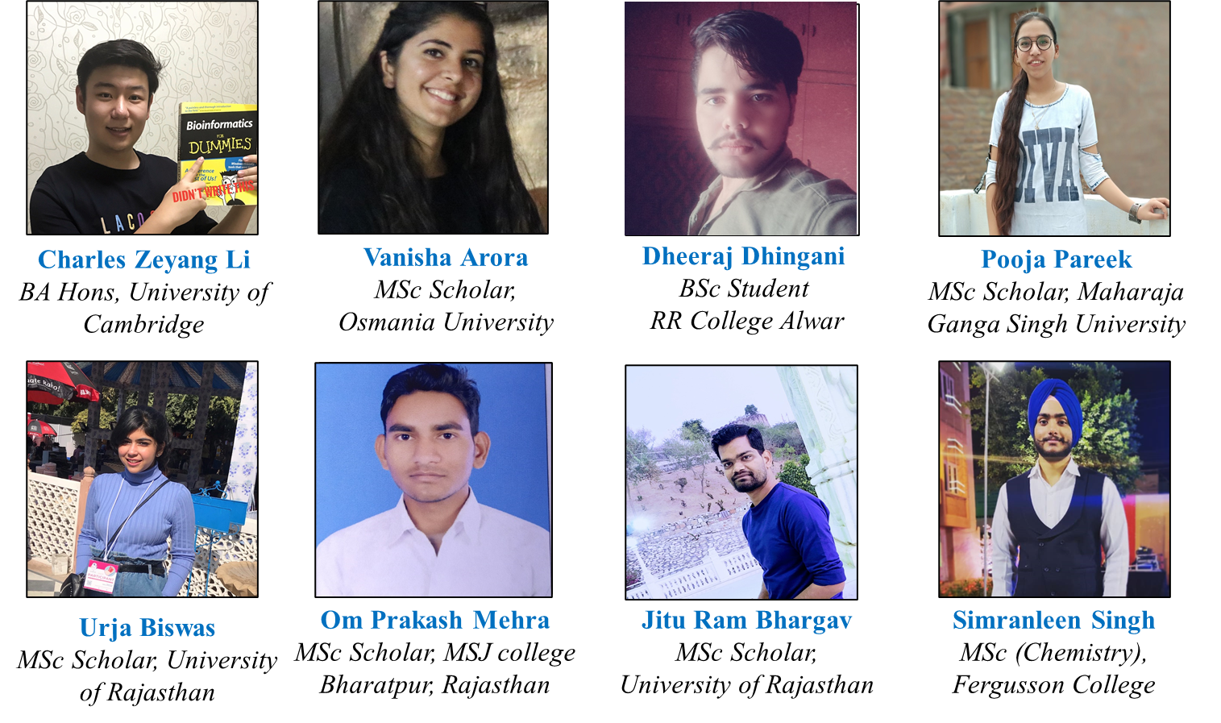
Our Colorful Team
UK, India, China

Slide 28

Useful Links
GITHUB Repository: https://github.com/petermr/openVirus
Presentations/Videos : https://www.youtube.com/watch?v=XiTngk-POm8
https://youtu.be/AXmqMMGiZUw
Viral epidemics and country
Details : https://github.com/petermr/openVirus/wiki/miniproject:-viral-epidemics-and-country
Dictionary : https://github.com/petermr/openVirus/wiki/Dictionary:-Country
Viral epidemics and diseases
Details : https://github.com/petermr/openVirus/wiki/miniproject:-viral-epidemics-and-disease
Dictionary : https://github.com/petermr/openVirus/wiki/Dictionary:-Diseases
Viral epidemics and drugs
Details : https://github.com/petermr/openVirus/wiki/miniproject:-viral-epidemics-and-drugs
Dictionary : https://github.com/petermr/openVirus/wiki/Dictionary:-Drugs
Viral epidemics and funders
Details : https://github.com/petermr/openVirus/wiki/miniproject:-viral-epidemics-and-funders
Dictionary : https://github.com/petermr/openVirus/wiki/Dictionary:-Funders
Viral epidemics and non pharmaceutical interventions
Details : https://github.com/petermr/openVirus/wiki/miniproject:-viral-epidemics-and-non-pharmaceutical-interventions
Dictionary : https://github.com/petermr/openVirus/wiki/Dictionary:-Non--pharmaceutical-Interventions
Viral epidemics and viruses
Details : https://github.com/petermr/openVirus/wiki/miniproject:-viral-epidemics-and-viruses
Dictionary : https://github.com/petermr/openVirus/wiki/Dictionary:-Viruses
Viral epidemics and zoonosis
Details : https://github.com/petermr/openVirus/wiki/miniproject:-viral-epidemics-and-zoonoses
Dictionary : https://github.com/petermr/openVirus/wiki/Dictionary:-Zoonosis
Testing and tracing in viral epidemics
Details : https://github.com/petermr/openVirus/wiki/MiniProject:Testing-and-tracing-in-viral-epidemics
Dictionary : https://github.com/petermr/openVirus/wiki/Dictionary:-Testing-and-Tracing
Some images Pixabay
Notes:
Add more

Slide 29

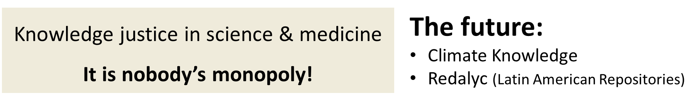
Our Inspiration
Repositories are for everyone everywhere
Save the time of the reader
The repository system is a growing communal organism
Credits: India Post, Government of India - [1], GODL-India, https://commons.wikimedia.org/w/index.php?curid=74877762; By Gennadi Blindmann (gblindmann@hotmail.com) - Photo, http://www.multi-touch-solution.com/, Public Domain, https://commons.wikimedia.org/w/index.php?curid=12145131; hudsoncrafted, Pixabay
Notes:
Ranganathan should come earlier
Graphic distracting
Something abour renganathan ( india – uk and back)
We go back to the foundations of library science and the laws of Ranganathan a century ago look to the past and present
Vision translates in this century to repositories
The value of repositories

Slide 30

Thank You
Credits: Pixabay

